Slide 1

PROBLEM STATEMENT: CYBERSECURITY RISK ASSESSMENT FRAMEWORK FOR SMALL BUSINESSES?
By Vir Kaviraj

Slide 2
INTRODUCTIOND
In today’s digital era, Small and Medium Enterprises (SMEs) rely heavily on information technology for operations such as communication, transactions, data storage, and customer management. While digital transformation improves efficiency and growth, it also exposes SMEs to various cybersecurity threats. Due to limited resources, expertise, and infrastructure, SMEs are more vulnerable to cyberattacks than large organizations.
Cyber threats like phishing, ransomware, insider threats, password attacks, and data breaches can cause financial loss, operational disruption, data compromise, and reputational damage. In some cases, even a single attack can threaten business continuity.
To address these risks, SMEs need a structured cybersecurity risk assessment framework to identify threats, evaluate their likelihood and impact, and implement effective mitigation strategies.
This project develops such a framework tailored for SMEs, analyzing common risks, designing a risk evaluation model, and proposing practical mitigation strategies. It is validated through case studies to demonstrate its effectiveness in real-world scenarios, aiming to provide a scalable approach to protecting business assets and data.

Slide 3
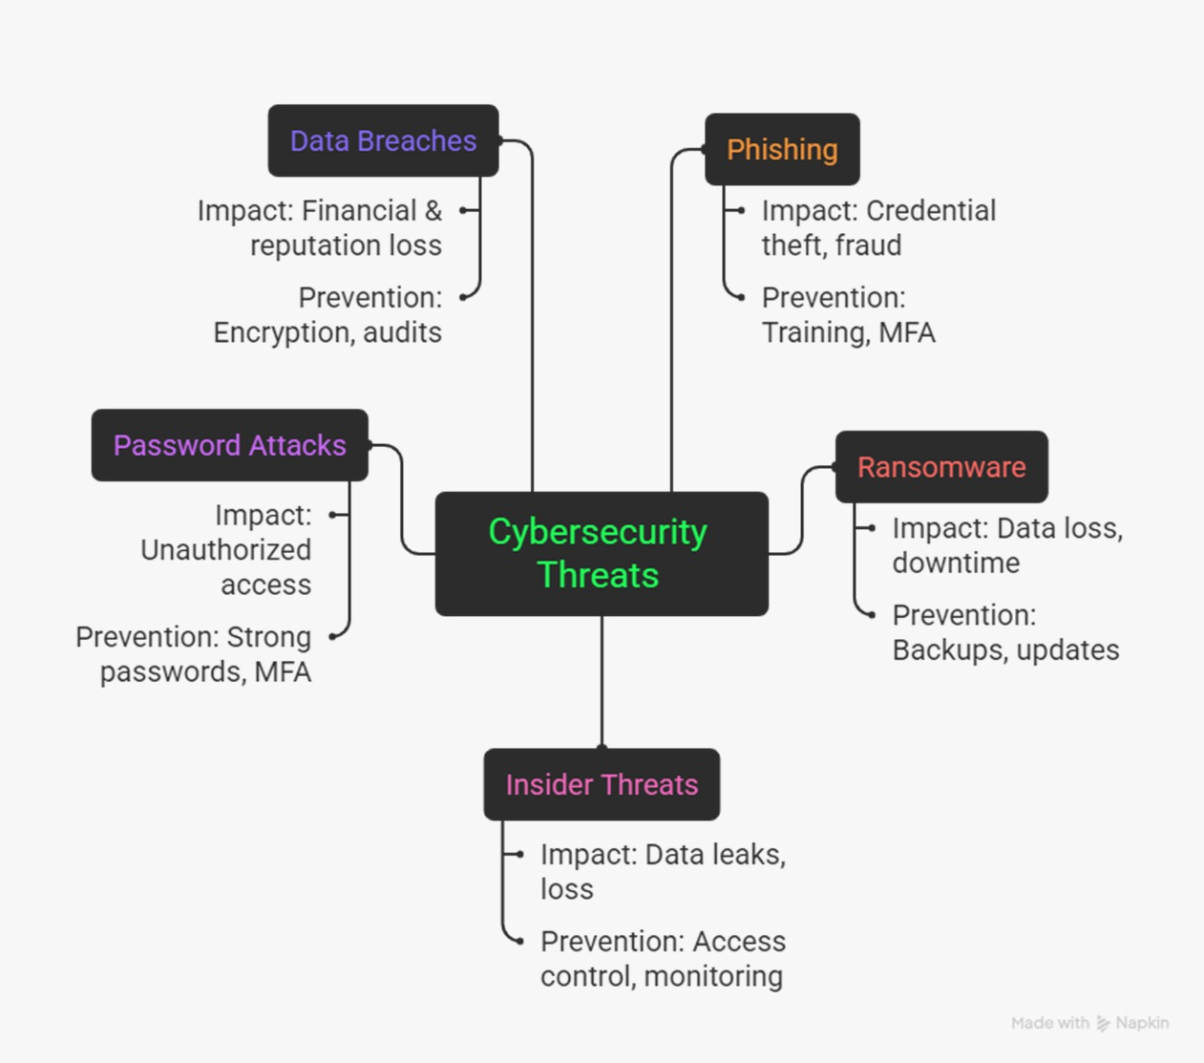
COMMON CYBERSECURITY RISKS IN SMES?

Slide 4
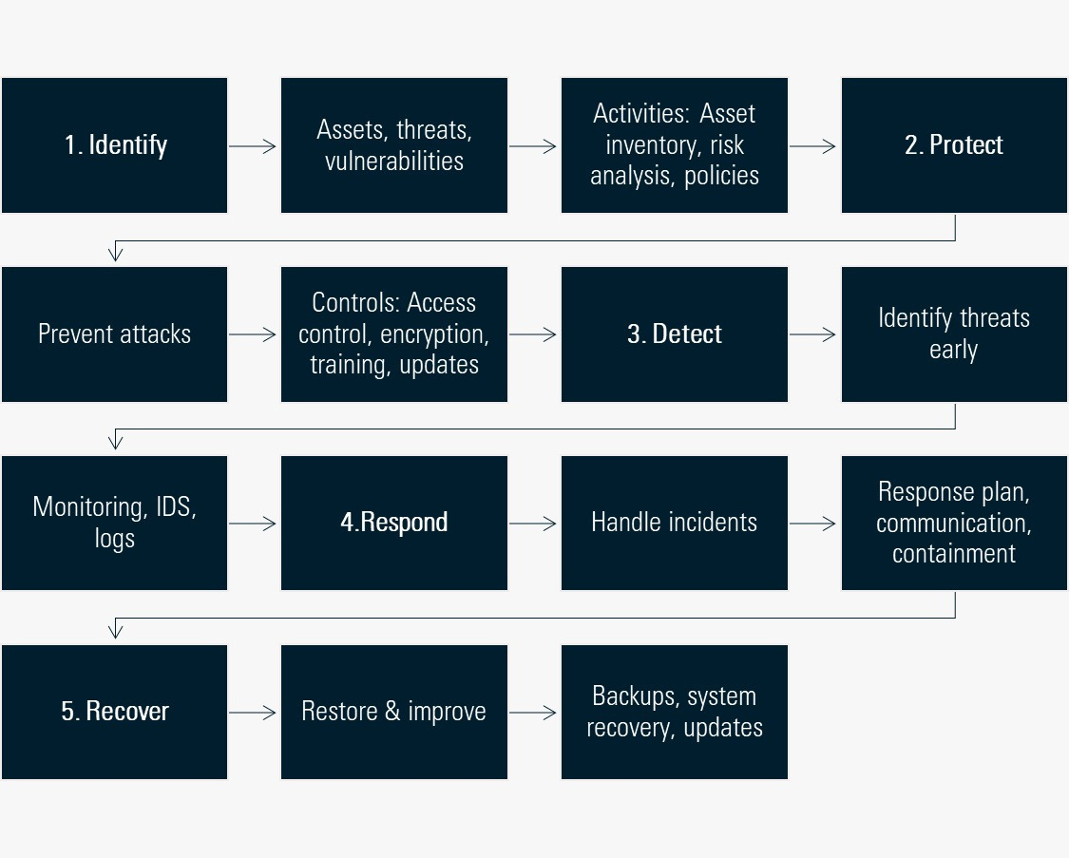
CYBERSECURITY FRAMEWORK (NIST MODEL)

Slide 5
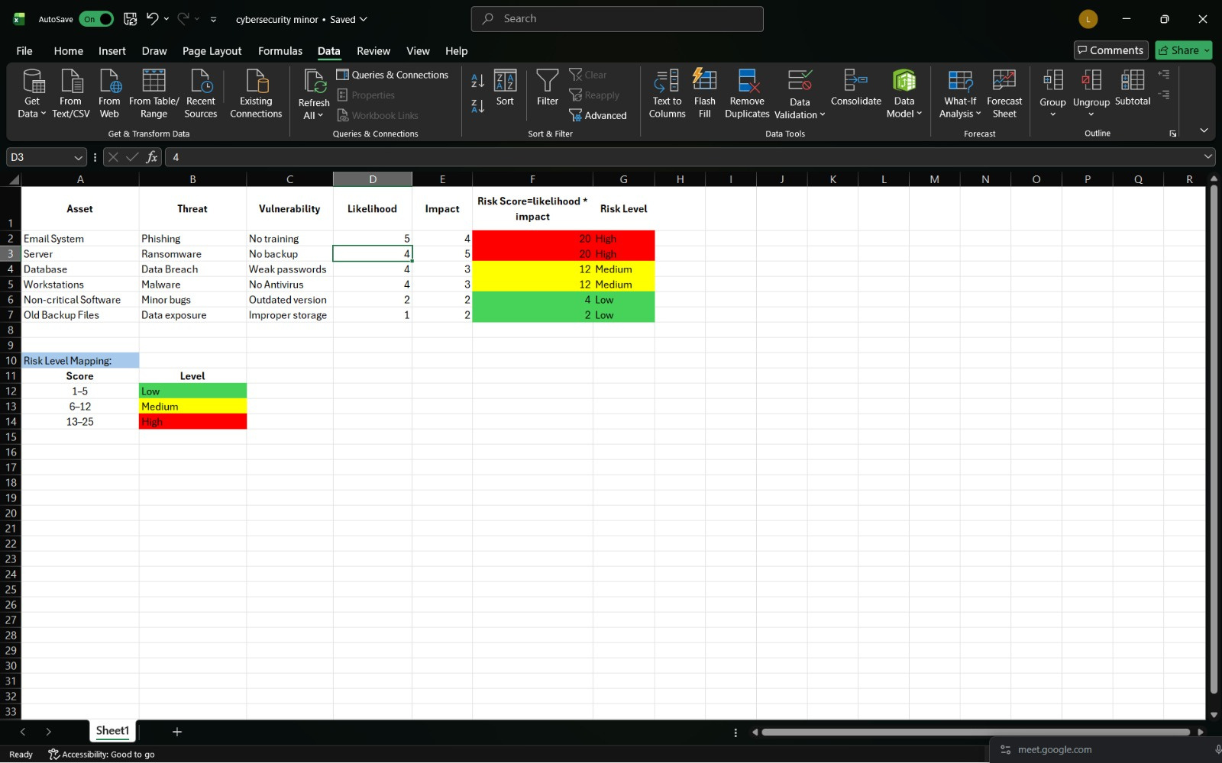
RISK EVALUATION METRIC

Slide 6
RISK ASSESSMENT TABLE
STRUCTURE
Asset, Threat, Vulnerability
Likelihood (1–5), Impact (1–5)
Risk Score = L × I
Risk Level: Low / Medium / High
Risk Levels
🔴 High (13–25) → Immediate action?🟡 Medium (6–12) → Monitor & improve?🟢 Low (1–5) → Acceptable
Key Insights
High risk → Critical systems
Medium → Needs attention
Low → Low priority
Importance
Prioritizes risks
Improves decision-making
Enhances security posture

Slide 7
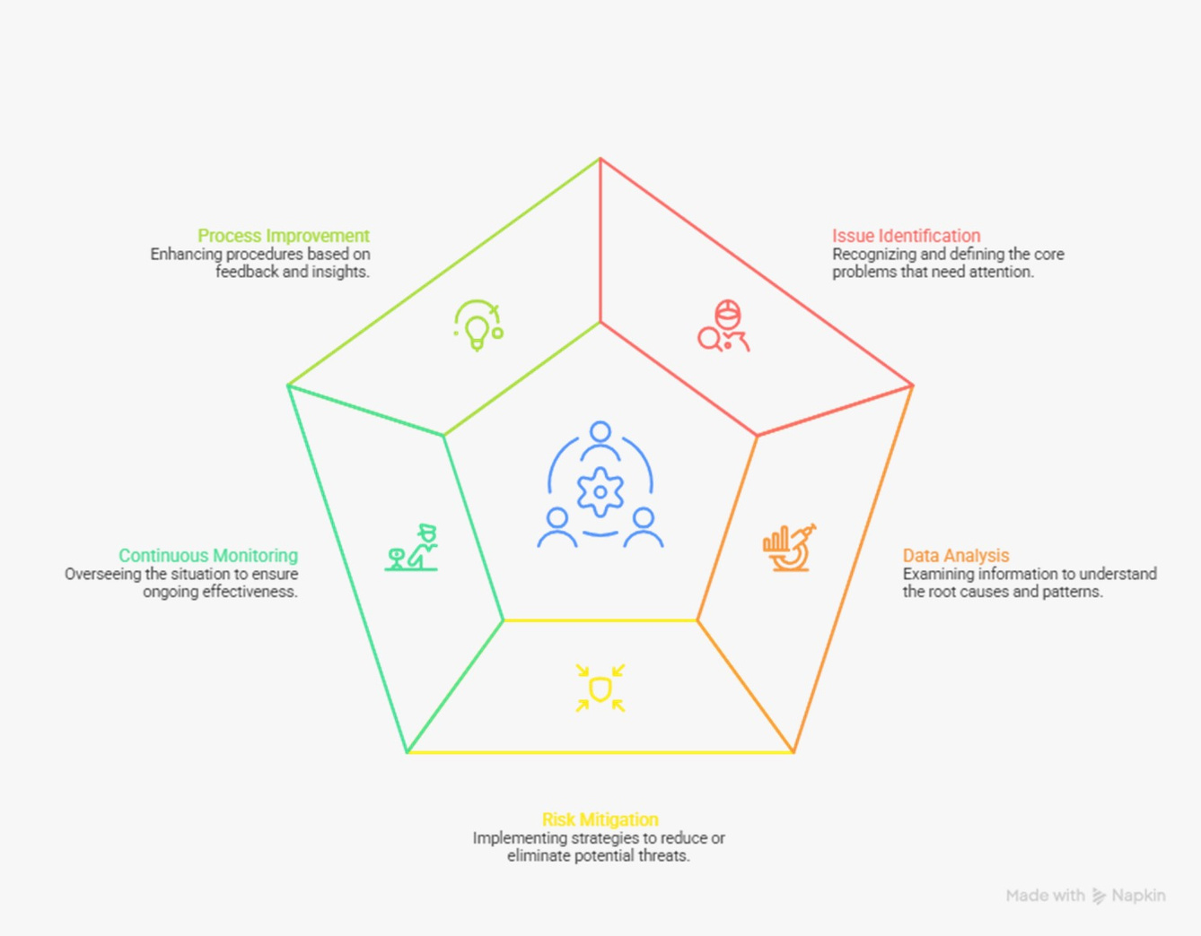
RISK MITIGATION STRATEGIES?

Slide 8
VALIDATE THE MODEL
What is Validation?
Testing model in real-world scenarios
Uses hypothetical SME case studies
Why It’s Important
Ensures model is practical
Shows real-world applicability
Identifies gaps/limitations
Highlights industry differences
Improves credibility

Slide 9
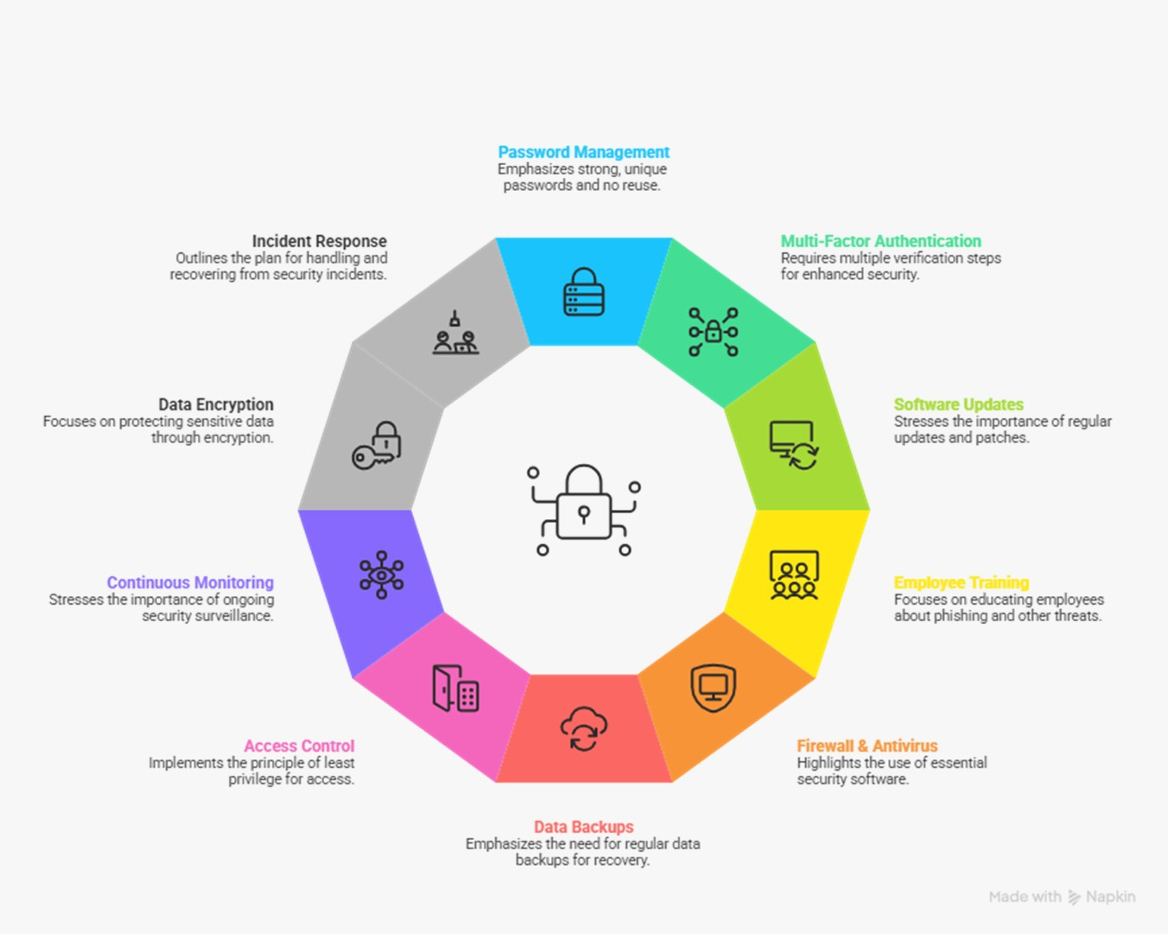
DOCUMENT FINDINGS AND BEST PRACTICES FOR SME CYBERSECURITY
What are Findings?
Results from risk analysis & case studies
Key Findings
SMEs are highly vulnerable
Human error is a major risk
High-risk areas: Email, Accounts, Databases
Lack of basic controls (MFA, updates)
Model helps identify & prioritize risks
Purpose
Improves decision-making
Strengthens cybersecurity

Slide 10
REFERENCE
Ransomware Attacks on Critical Infrastructure: Effects and Prevention Strategies
An Overview of Malware Injection Attacks: Techniques, Impacts, and Countermeasures
Ransomware Threats

